Slide 1
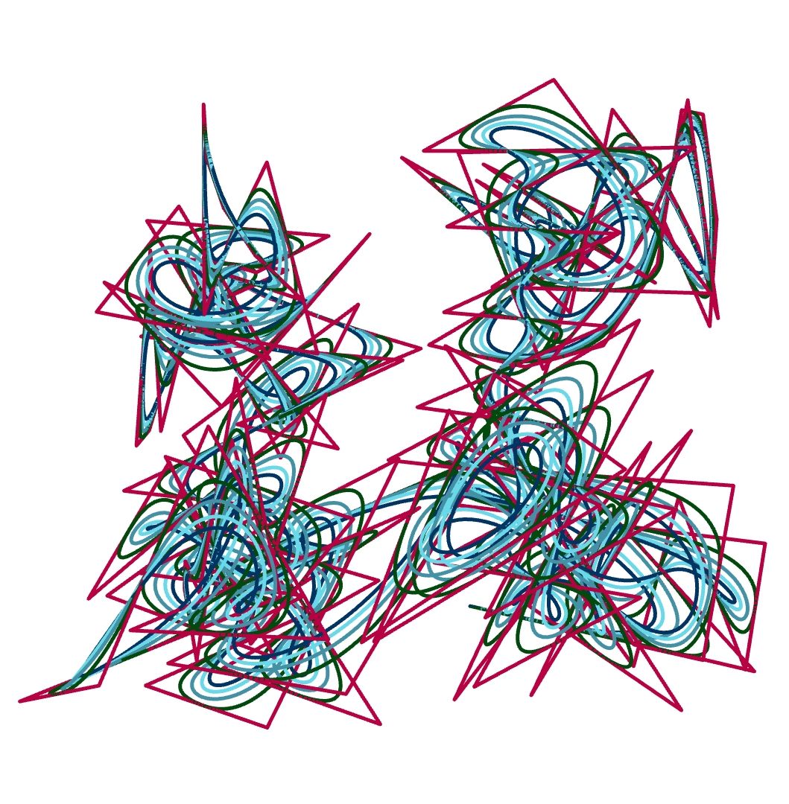
P#
<Computational Design Thinking>
<Generative Design>
P#
BEST PICTURE
Assignment
Context
Course
Date
Generative
Design
Freshmore
Term 1
Computational
Design Thinking
2020
Student
<Description>
Lim Thian Yew
1003158
The objective of the project is to make a computer-generated design that is mathematically / computationally infeasible for a human to replicate.
Inspired by epicycle tutorials during class but felt that the tutorial examples were aesthetically lacking due to predictability of the structure.
The design aims introduce some unpredictability and asymmetry by creating curves where all the points are generated using trigonometric functions modulo 10. This also has the interesting effect of constraining the entirety of the art within a bounding box. However, effort has also been made to avoid a bad aesthetic arising from overly chaotic generated patterns.
The design is shifted across the y-axis as well too introduce slight asymmetry, as well as adding a subtle 3D effect.
Instructor
Jason Lim
Lecturer

Slide 2
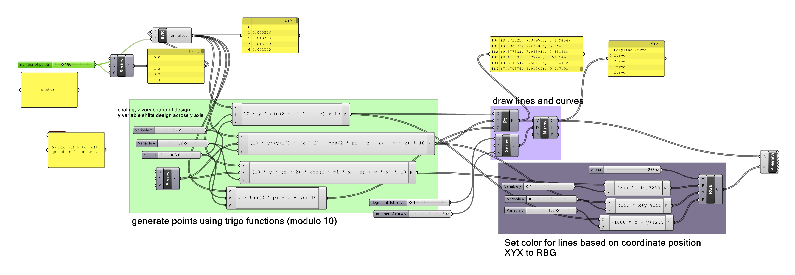
P#
<Computational Design Thinking>
<Generative Design>
P#

Slide 3
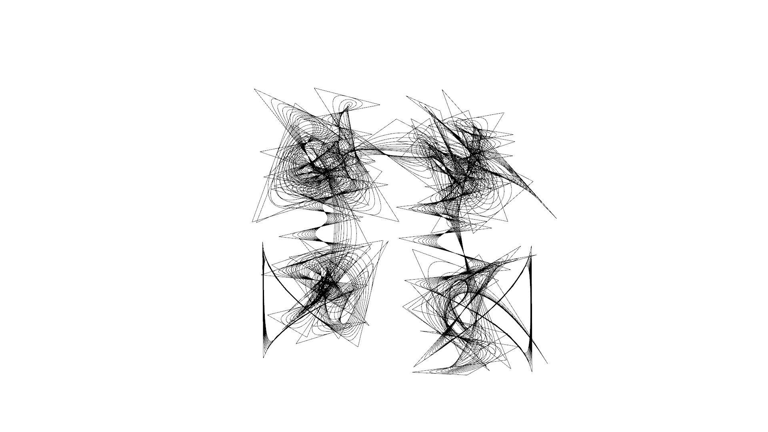
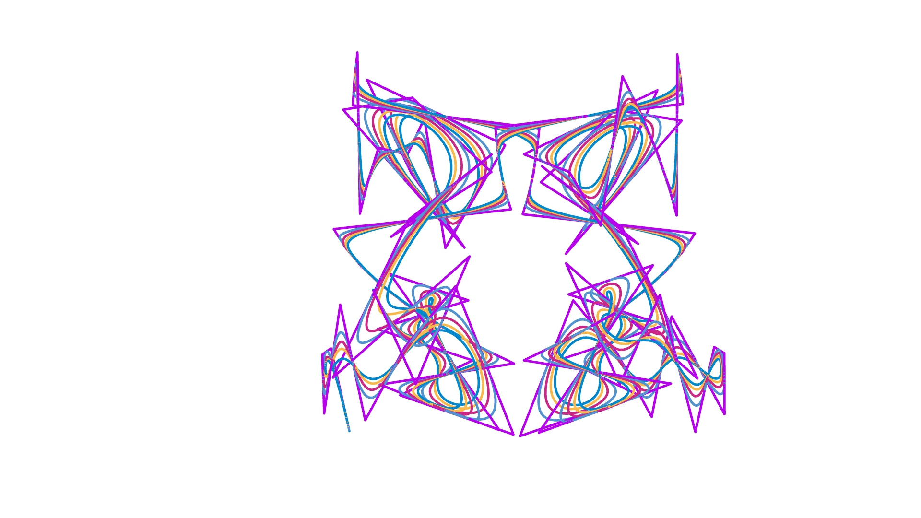
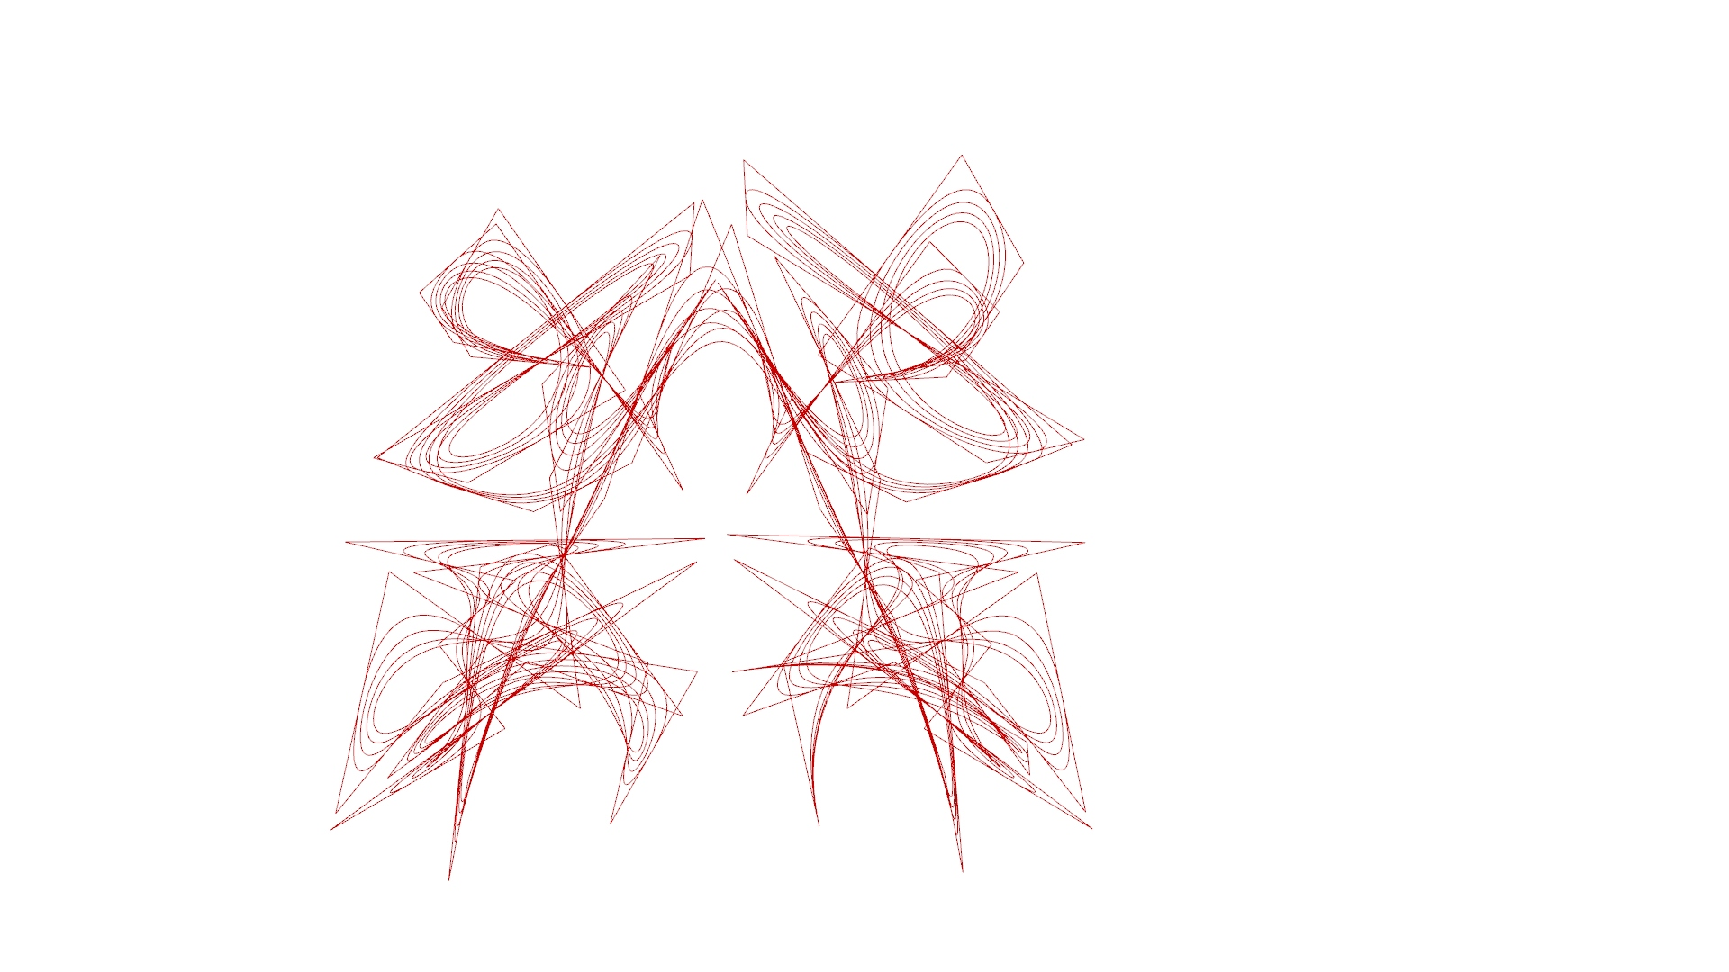
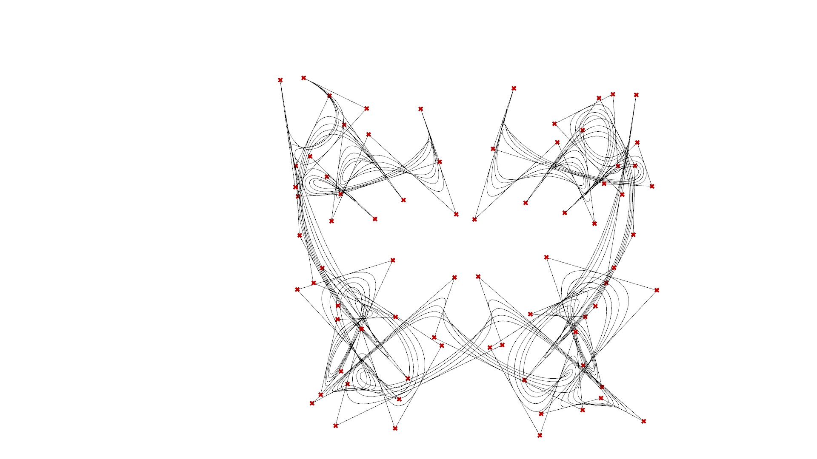
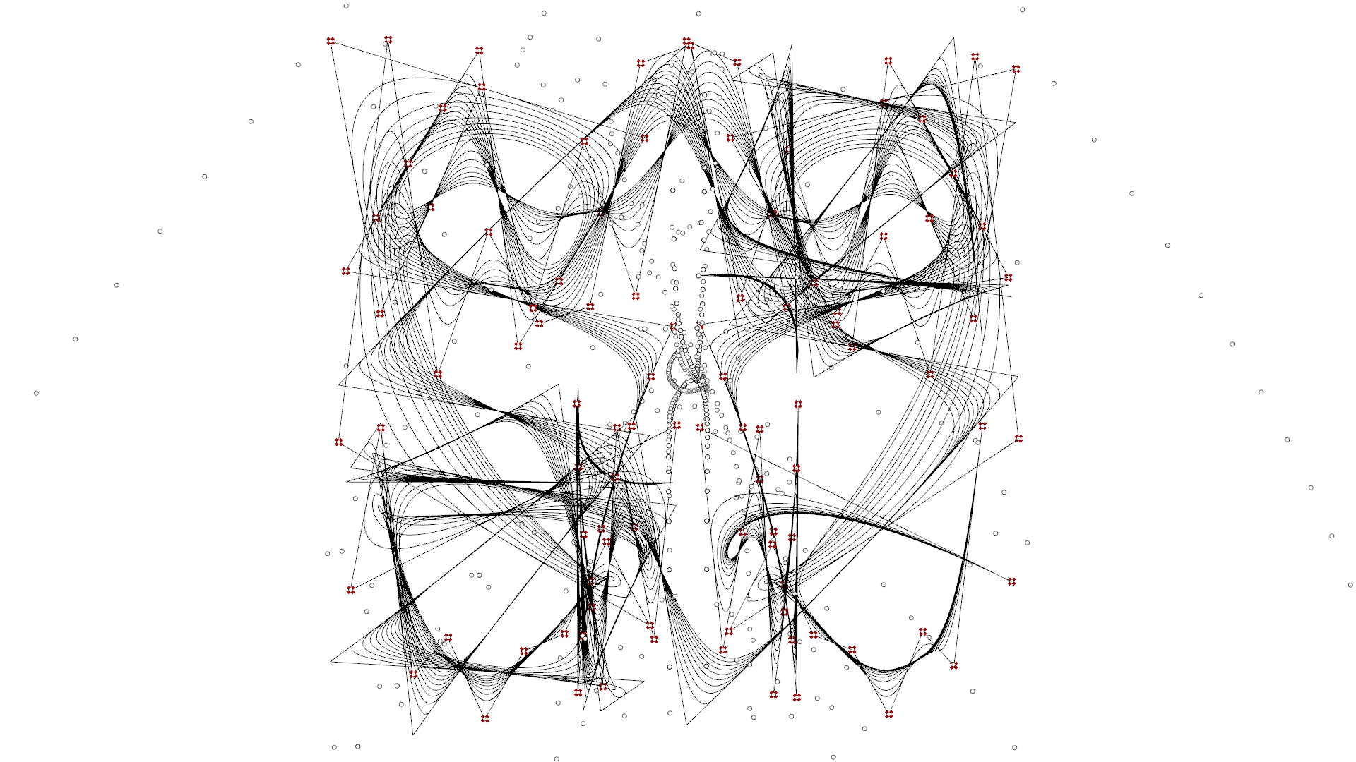
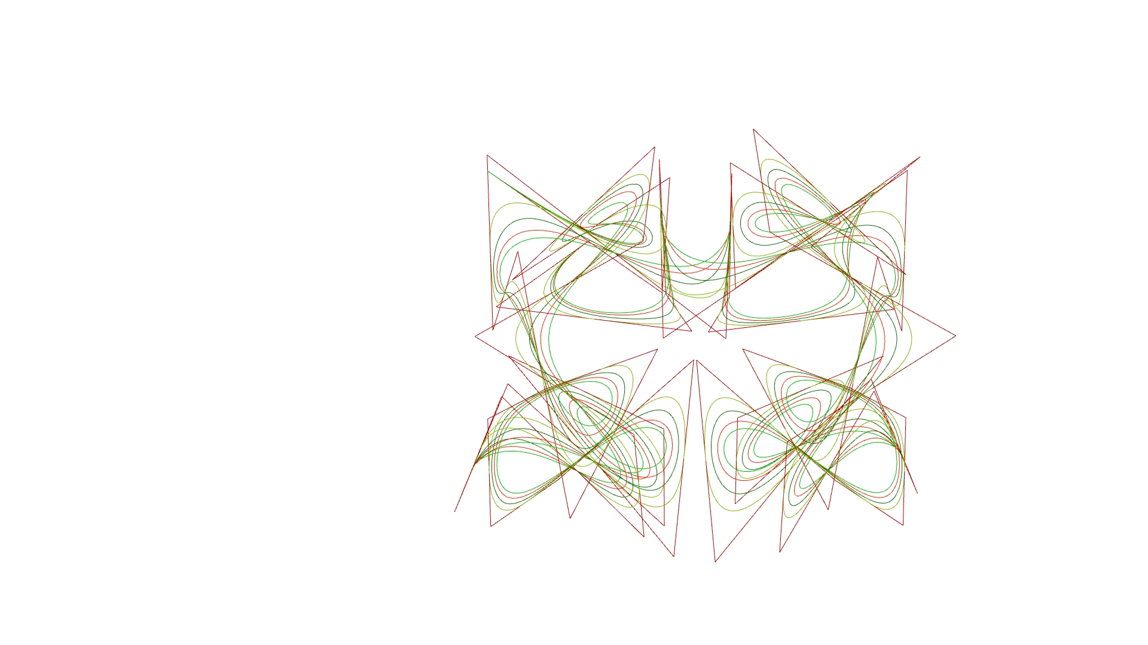
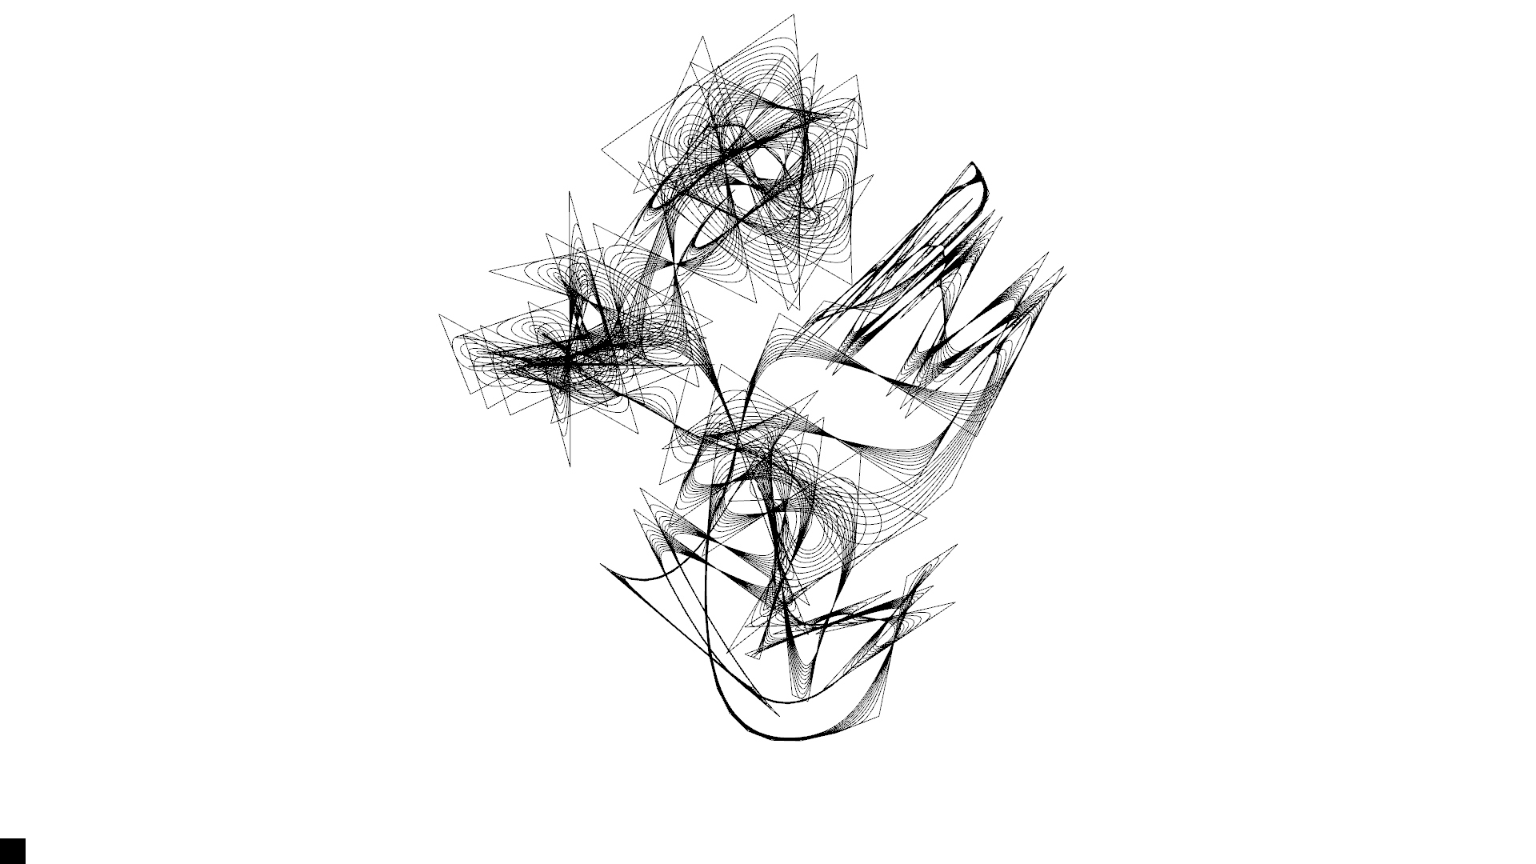
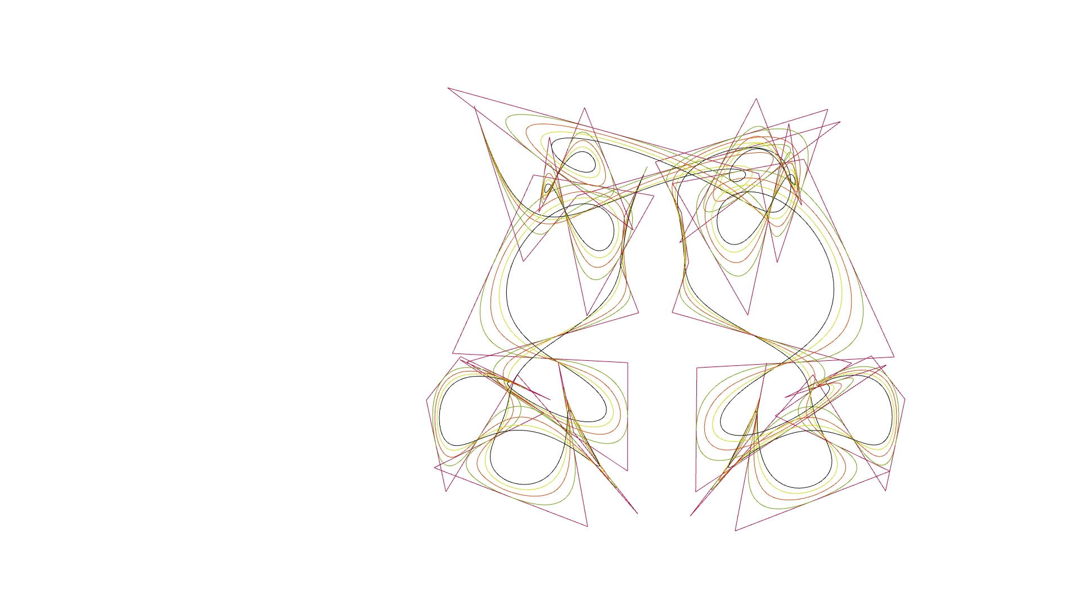
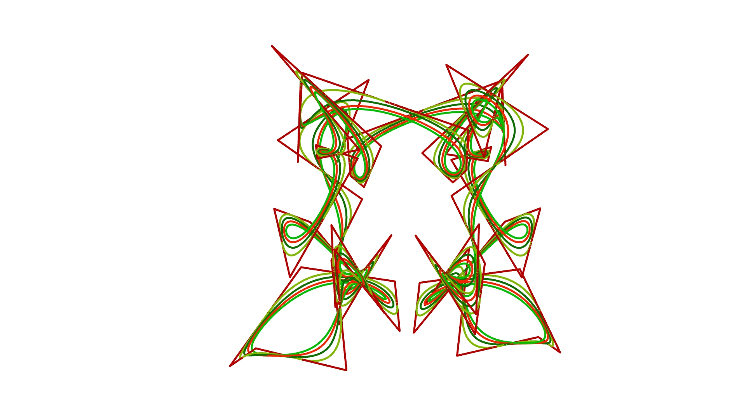
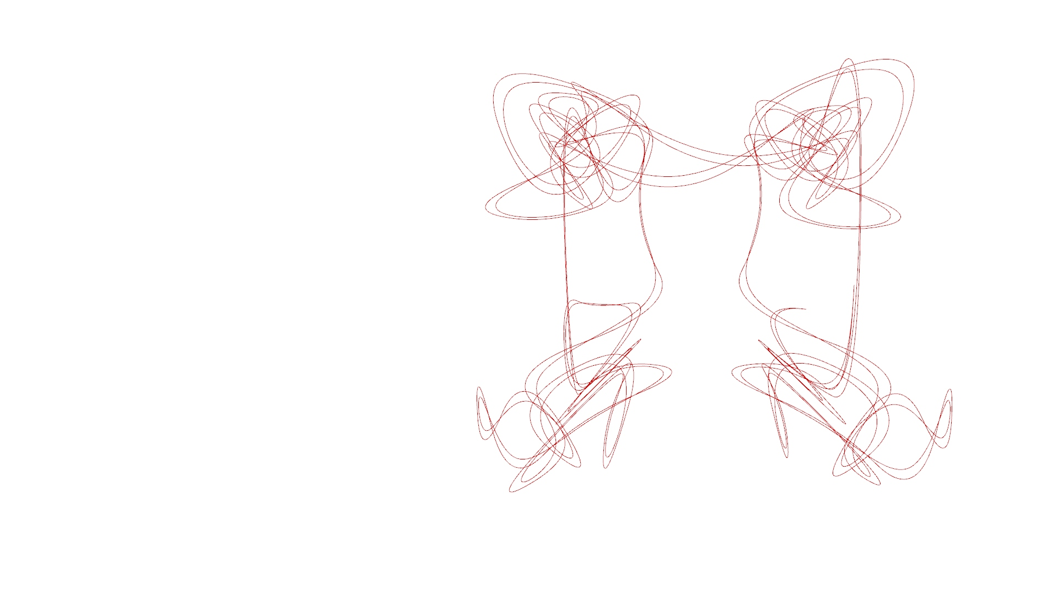
P#
<Computational Design Thinking>
<Generative Design>
P#
<Layout Rules>
High number of curves and points
Fewer curves, more points, sharper lines
Introduction of color
Red color only
Include colored points in design
More curves, more stretched out points
Subtle changes of yellow per curve
Humanoid shape in design
Curves only in design
Initial designs were in black and white, and lines were much thinner. Line coloring based upon line position was not added until much later into the assignment.
1/8
1/8
1/8
1/8
1/4
1/8
1/8
Captions
01 black, more points
02 chaotic points
03 colored points
04 red color
05 Include points
06 more curves
07 symmetrical-ish
08 subtle colors
09 Curves only
1/8
1/8
02
03
04
05
01
06
07
08
09

Slide 4
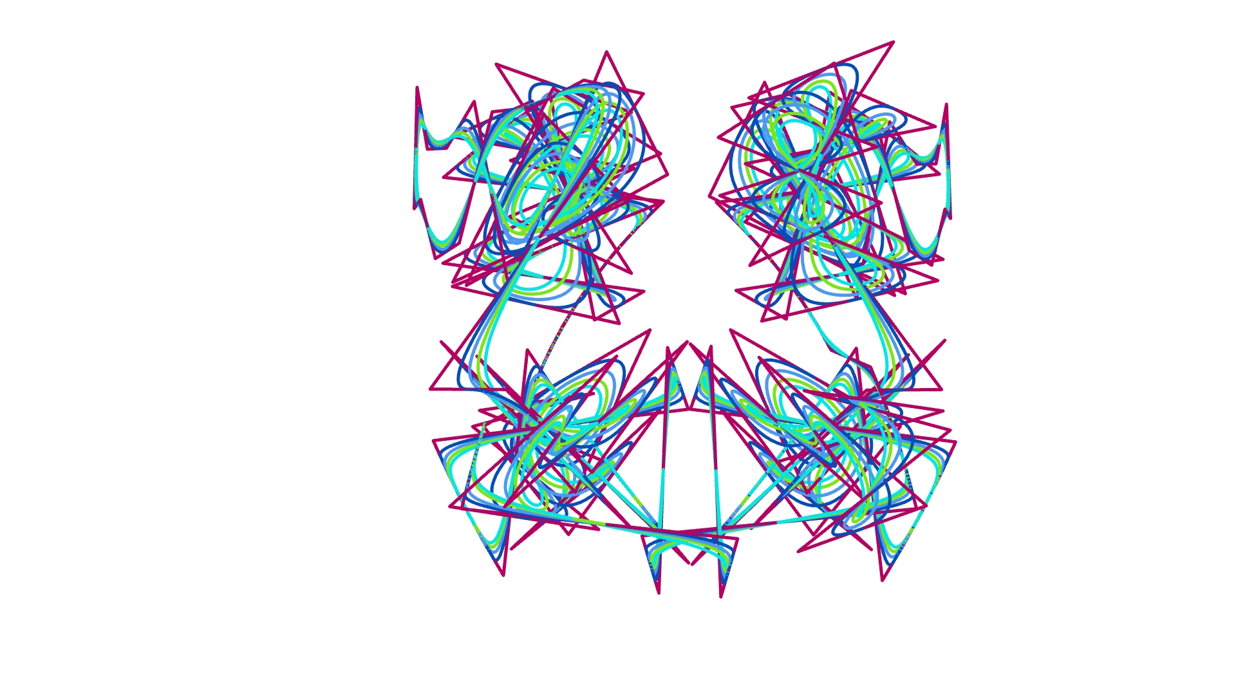
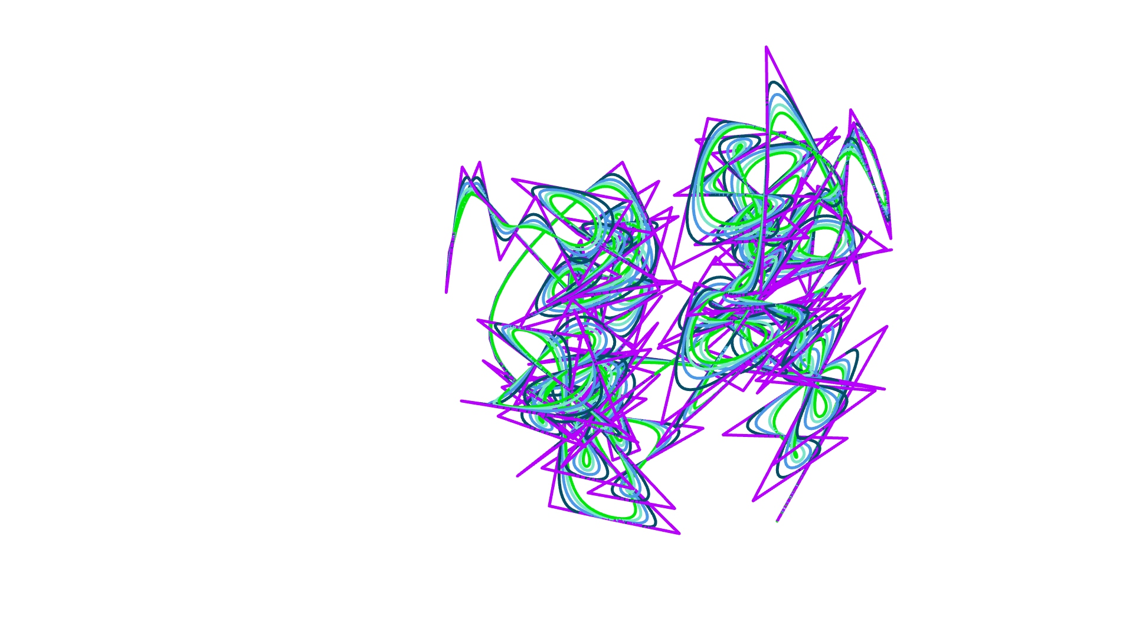
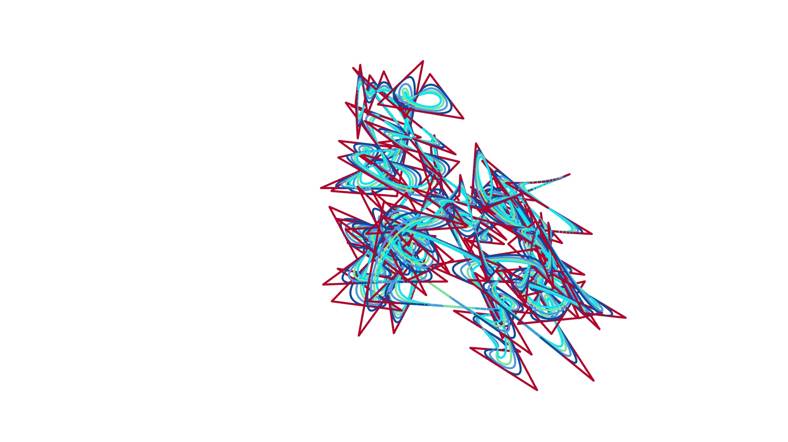
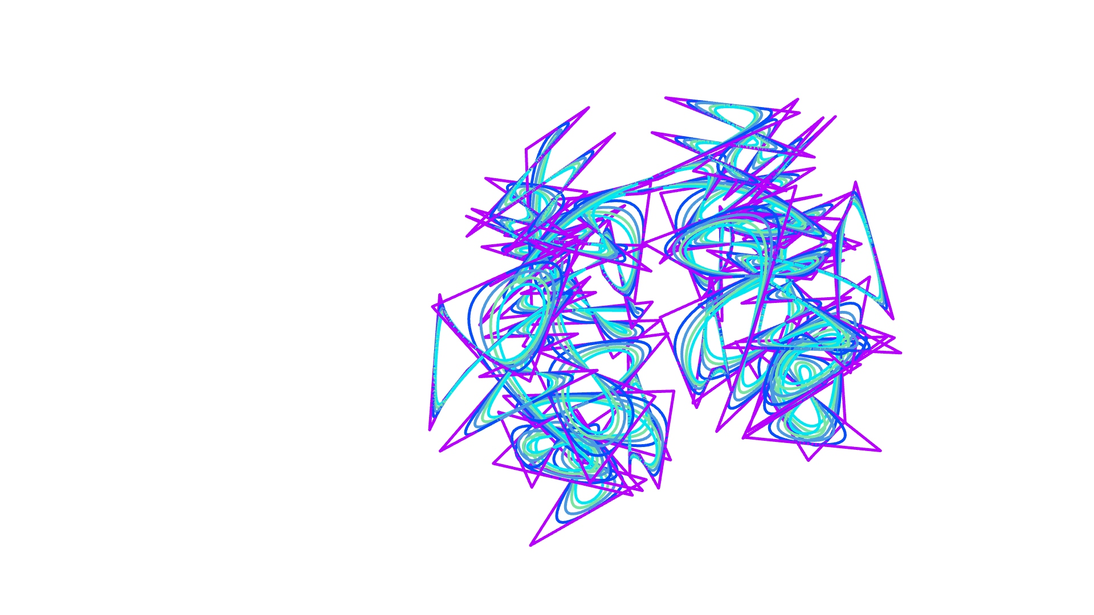
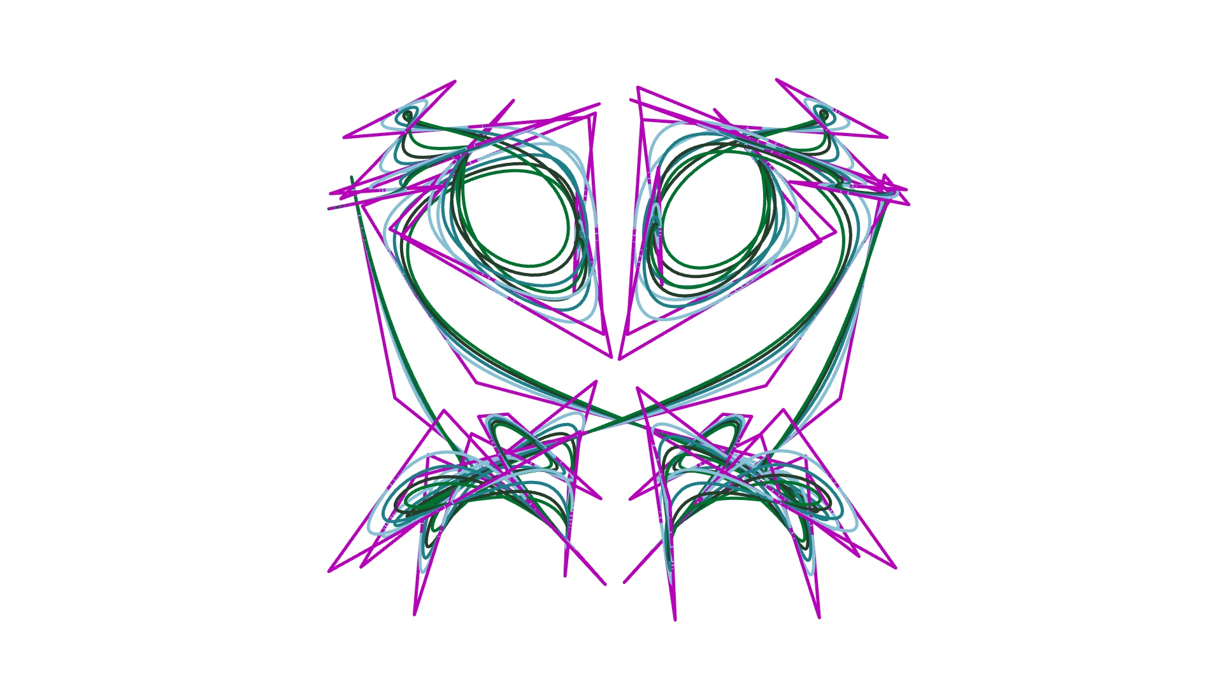
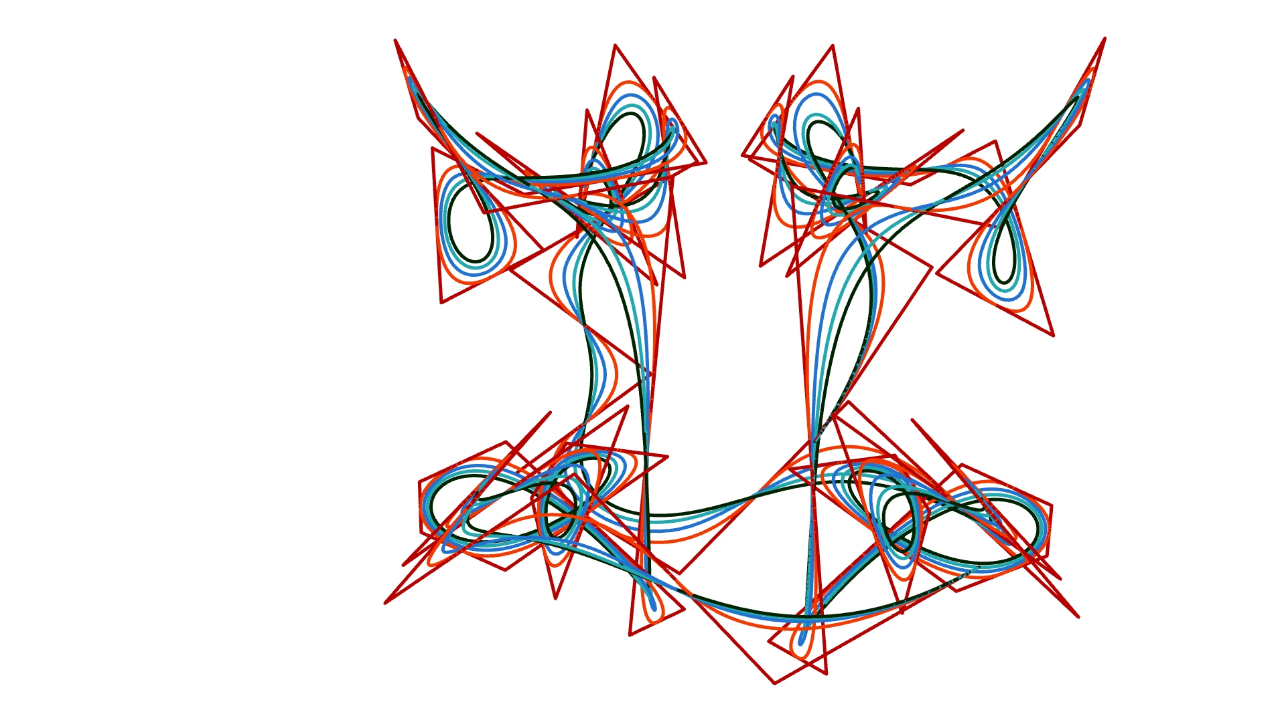
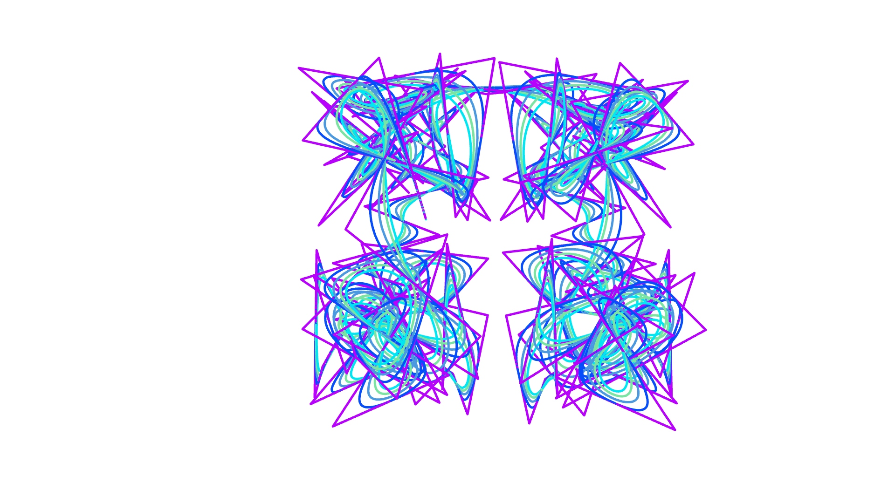
P#
<Computational Design Thinking>
<Generative Design>
P#
1/4
1/4
1/4
1/4
1/2
1/4
Captions
01 symmetrical-ish
02 jagged lines
03 monster face
04 purple palette
05 light color palette
06 fewer points
07 bird-like
1/4
01
04
02
05
03
06
07

Slide 5
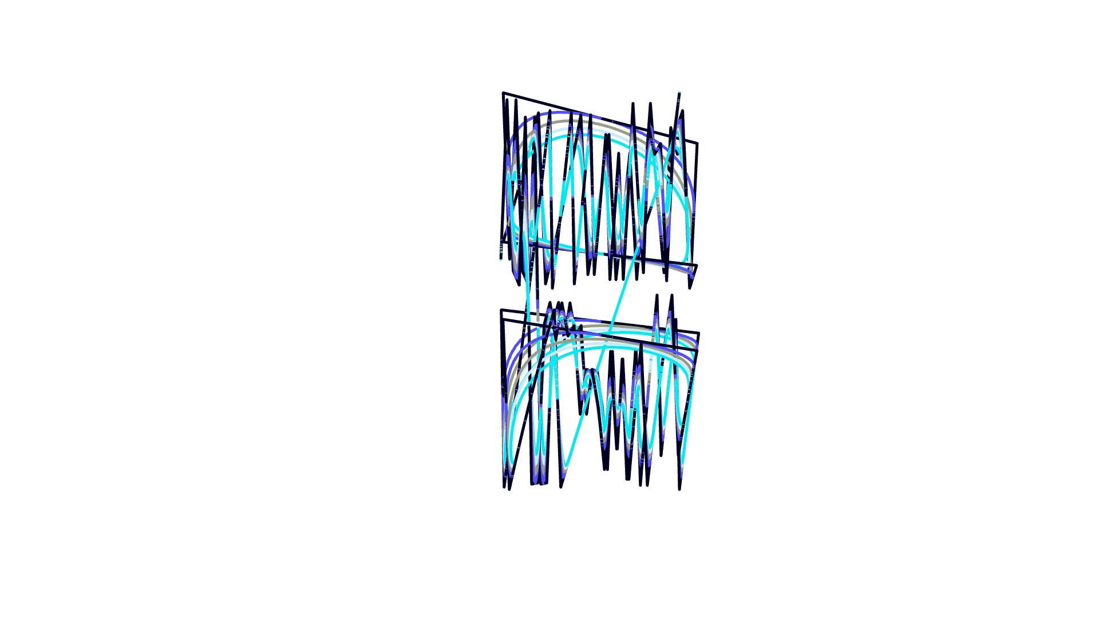
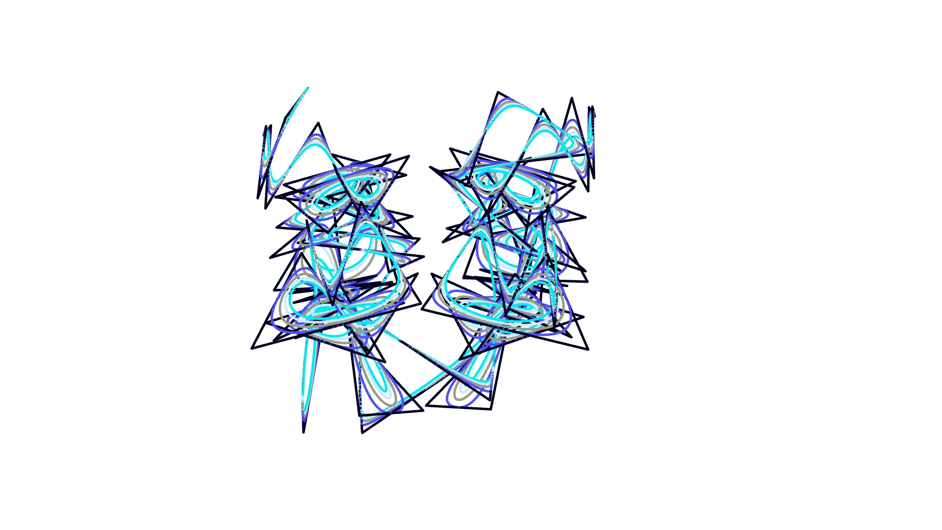
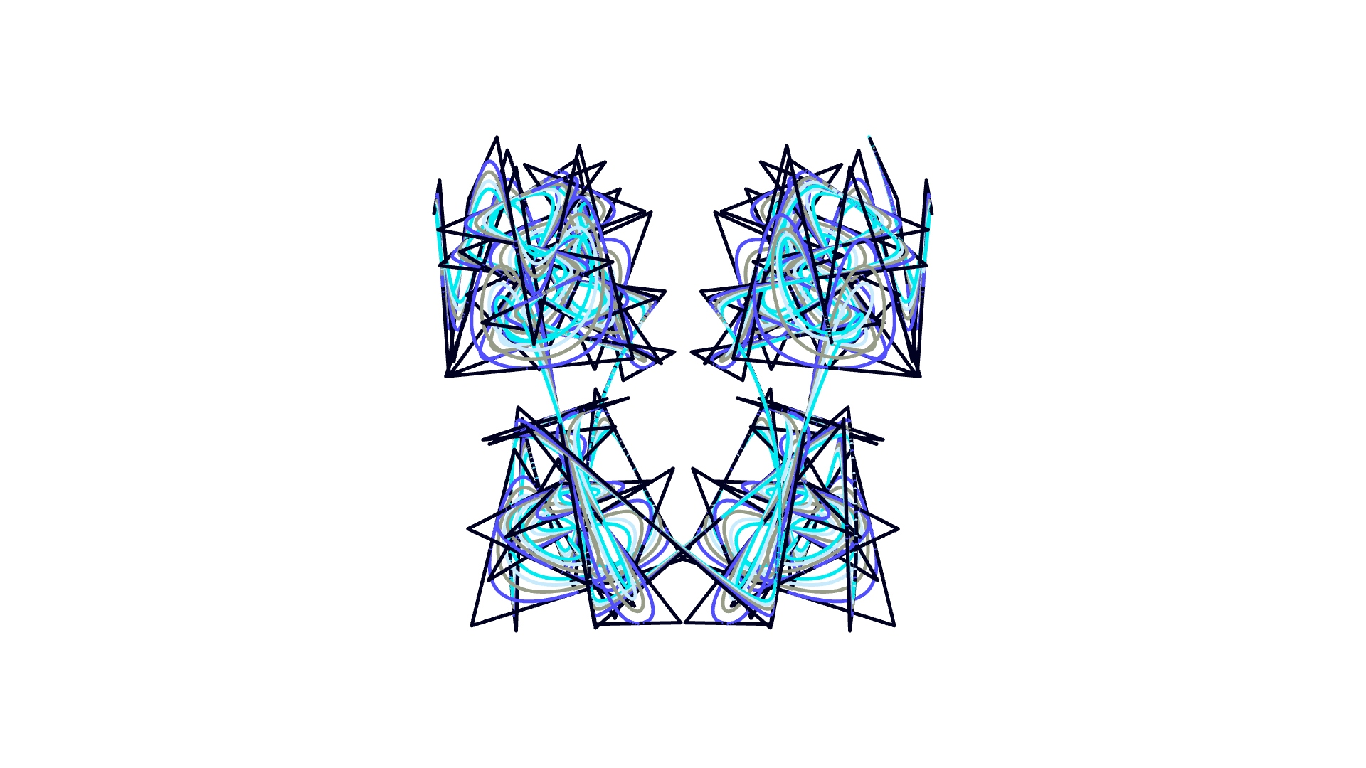
P#
<Computational Design Thinking>
<Generative Design>
P#
4/4
1/2
1/2
Captions
01 Perspective view
02 side view
03 front view
01
02
03

